Slide 1

Critical Design Review
Team 28 - SharkCam
Liron Dubin | Kevin Vasquez | Sophia Delia | Brett Senders | Alex HP
Notes:
Brett

Slide 2
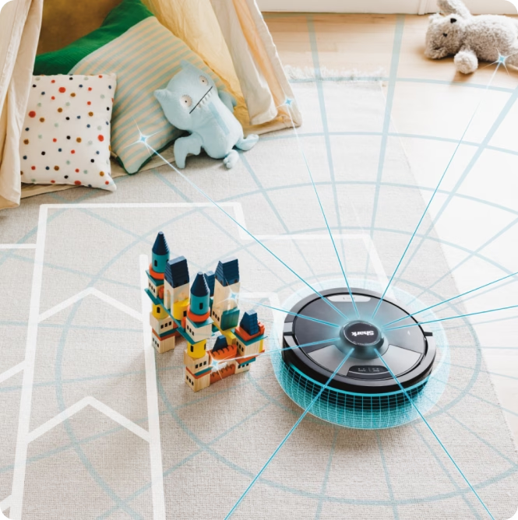
SharkCam Overview
Task:
Design an accessory for SharkNinja’s vacuum robot to give it new functionality
Requirements:
User-installable, non-destructive, & removable
Solution:
SharkCam turns the robot and a smartphone into an autonomous event photographer.
Notes:
Brett

Slide 3
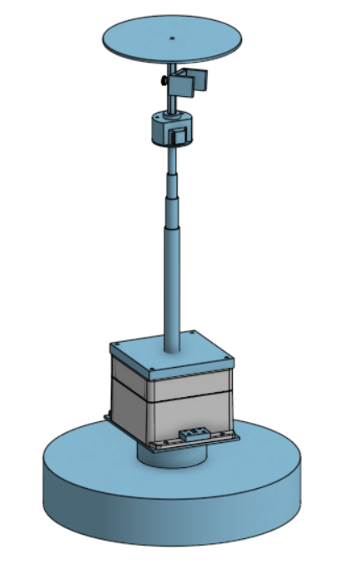
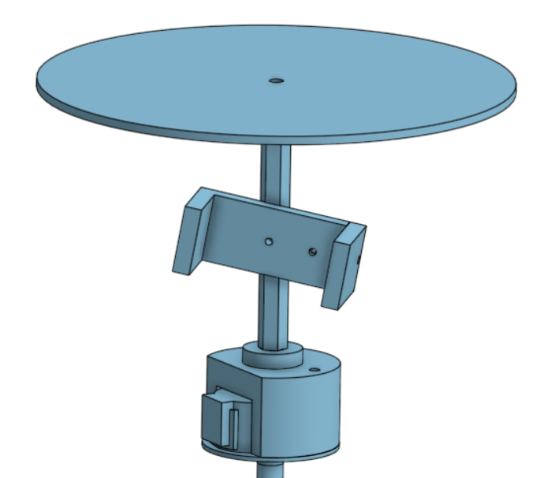
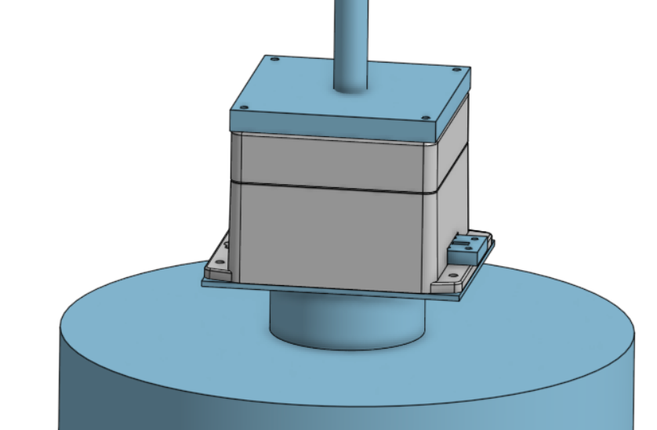
System Overview - Hardware
Phone mount assembly
Top plate (distance sensor target)
Telescoping Column
Phone holder
Stepper motor
Electronics Bay - secured to base plate with hand bolts
Base
Distance sensor
Robot
Semi-permanent base plate (secured with VHB)
Notes:
Liron

Slide 4
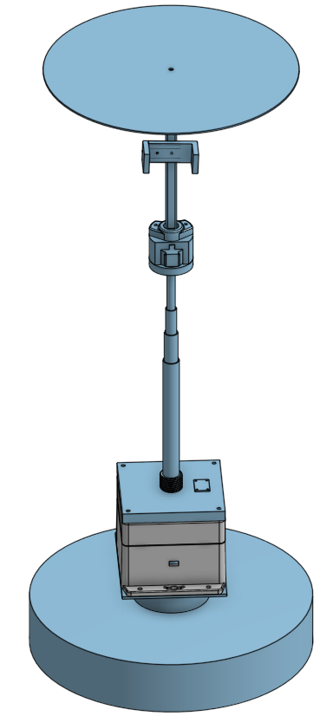
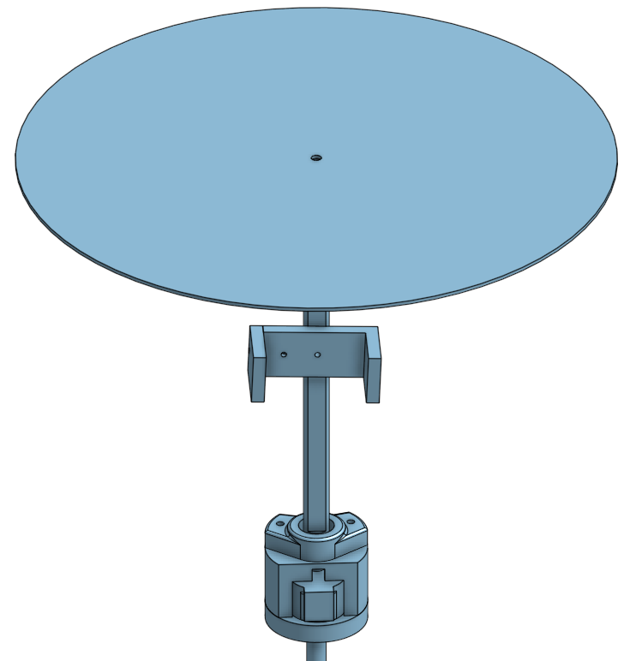
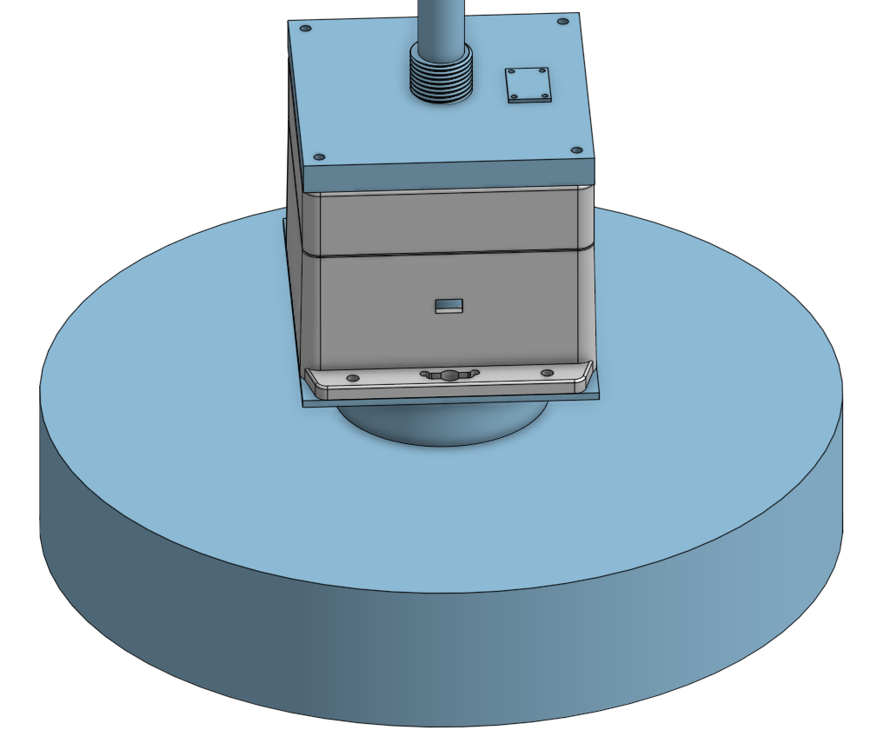
Top plate (distance sensor target)
Phone mount assembly
Phone holder
Telescoping Column
Stepper motor assembly
Distance sensor
Base
Electronics Bay - secured to base plate with hand bolts
Robot
Semi-permanent base plate (secured with VHB)
Notes:
Liron

Slide 5
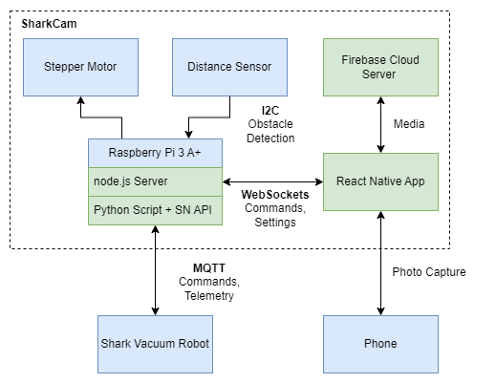
Block Diagram - Full System
Major Changes:
Raspberry Pi replaces both ESP32 and cloud server
React Native app replaces Flask web app
Distance sensor replaces force sensor
Notes:
Brett

Slide 6
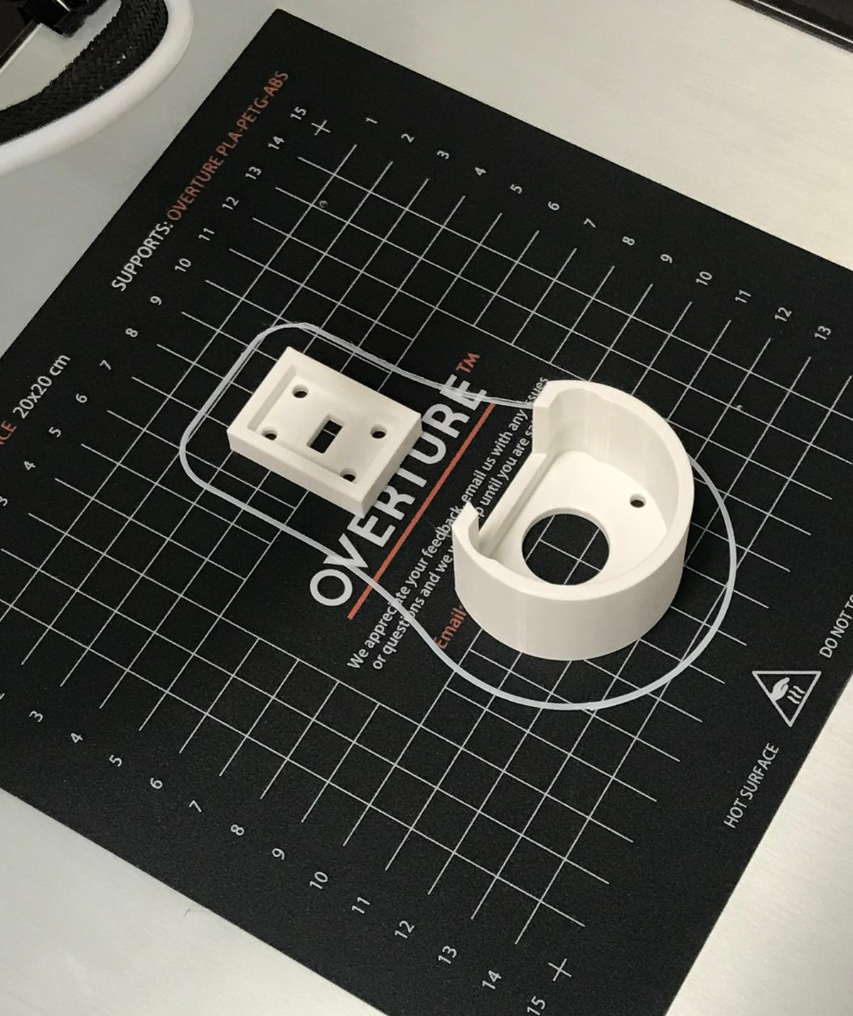
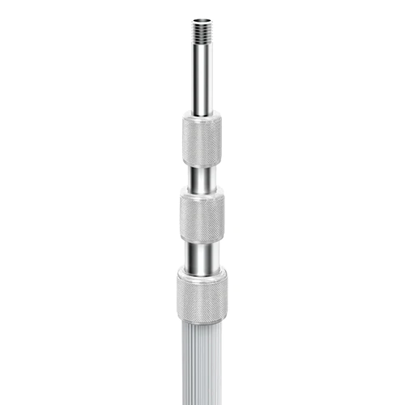
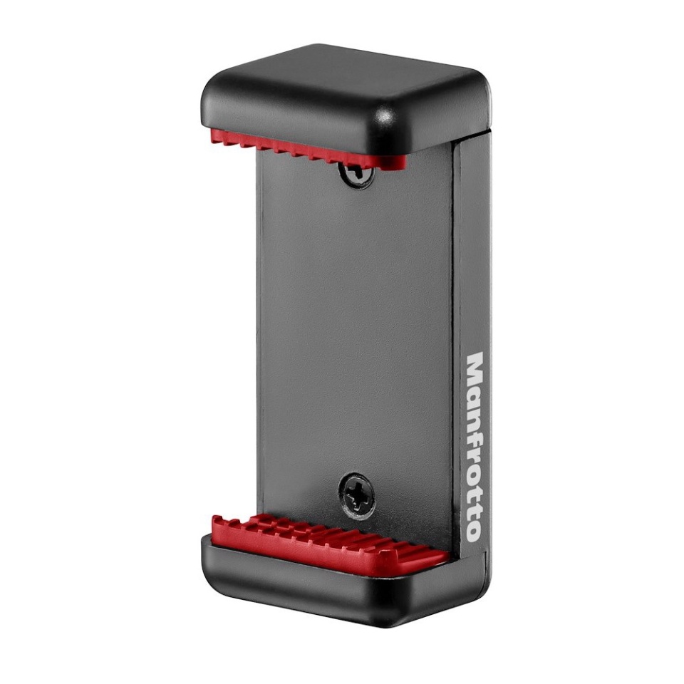
Hardware Materials/Sourcing
Column - modified Testrite aluminum column
Phone gripper - Manfrotto
Top plate - laser cut acrylic
Elecontrics bay - modified ABS container from mcmaster
Mounts for distance sensor and motor - 3D printed (PLA)
Base plate - PE
Notes:
Kev

Slide 7
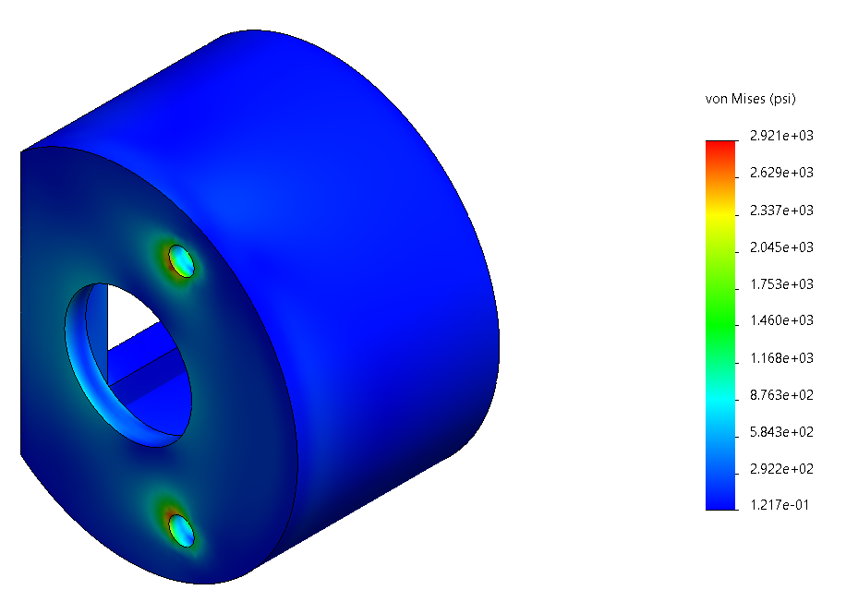
Mechanical Calculations
Tipping force of product <4lbs
Rod yields with force of >7lbs at max moment (½” section fails first)
Plates for electronics bay support max moment with FOS of >20
Bearing Support holds the load of the hex shaft with FOS of >2
Notes:
Liron

Slide 8
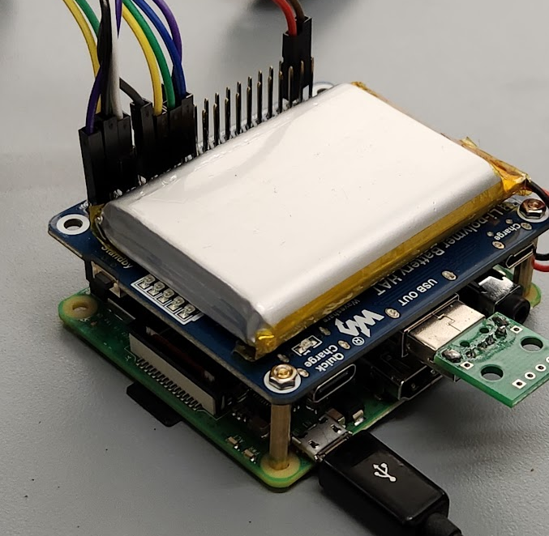
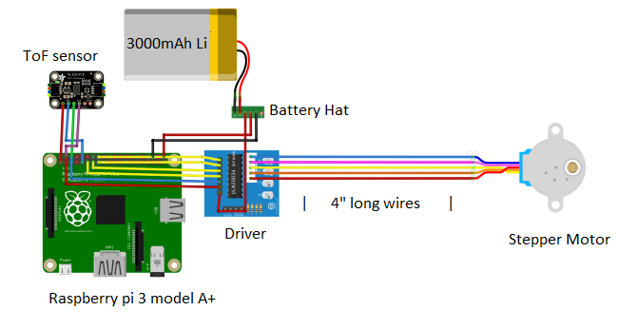
Electronics
Raspberry Pi 3 A+
3000 mAh Li-po battery
Battery “hat” to power the system
Time of flight sensor VL53L4CD
Stepper motor driver UNL2003A
Stepper motor
Rotates phone to take photos in all directions
Notes:
Alex

Slide 9
Old Application vs New Application
Old Application
Flask based
Web application
Written in Python / HTML
Containerized
New Application
Expo / React Native based
Run as phone application
Written in JavaScript
Notes:
Soph

Slide 10
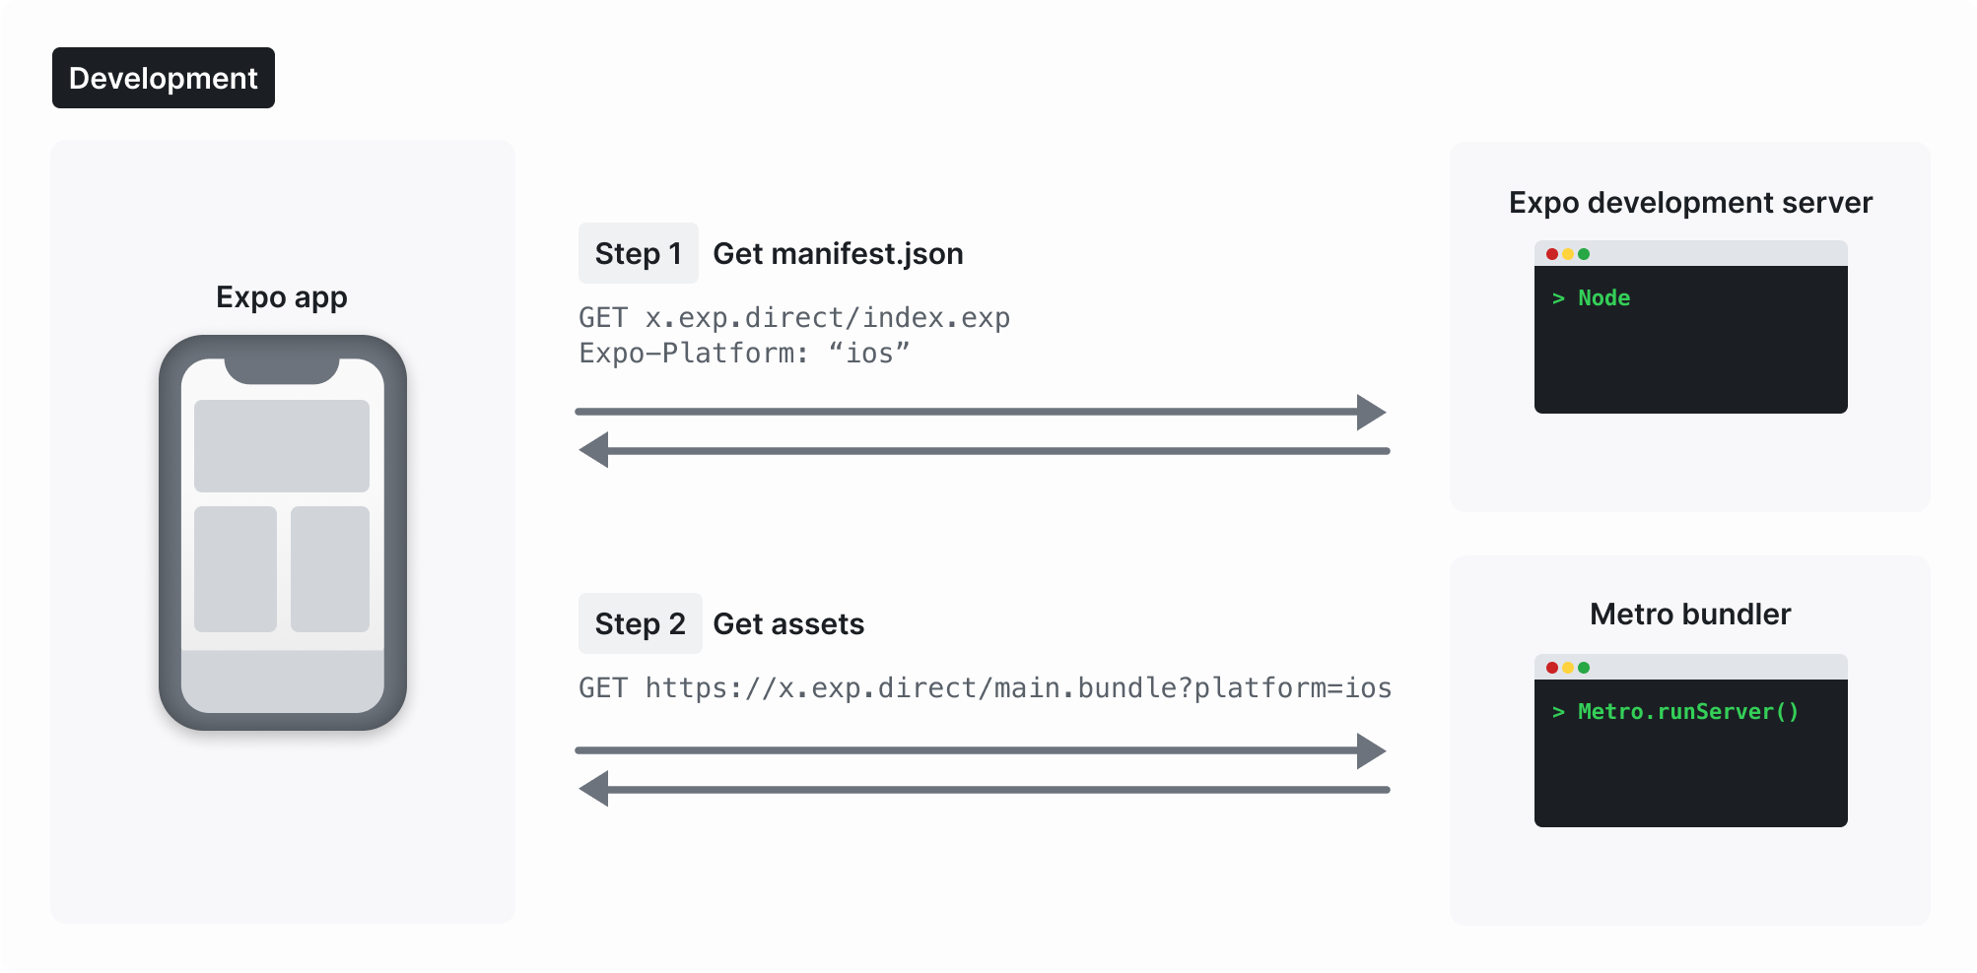
Expo + Expo GO
“Expo is an open-source framework for making apps that run natively on Android, iOS, and the web.” - Expo Docs
Expo Go: Mobile application development environment
Runs on mobile devices
Can interact with your application hardware - camera testing is possible!
Do not need a specific desktop environment (e.g. Mac/XCode) to develop mobile applications
Source: Expo Docs
Notes:
Soph

Slide 11
Application Modifications
React Native app solves compatibility issues with camera access on mobile devices with web app
Expo allows React Native application to be developed on any mobile OS
Eliminating containerization
No longer need to serve content on web constantly
Local server run for app development
Notes:
Soph

Slide 12
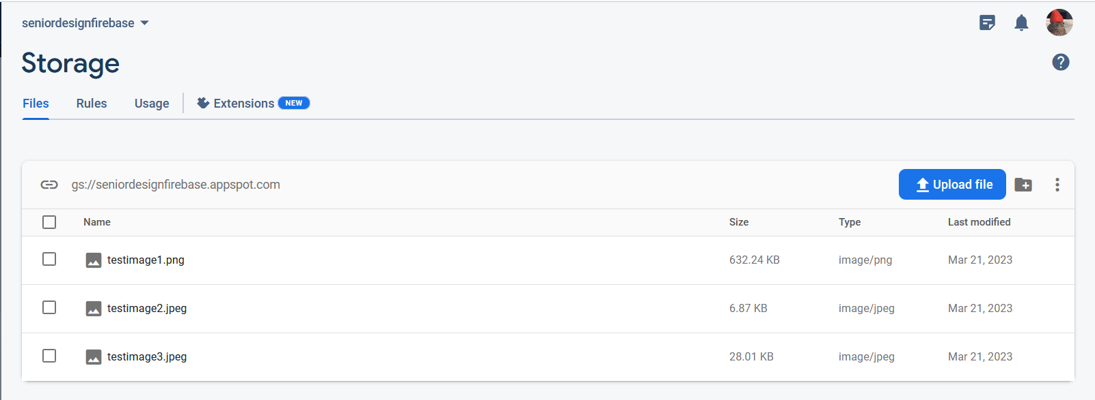
Firebase Media Server
React has a Firebase API
Lowest tier is free
Photos stored in cloud memory bucket
Use signed URL (temporary links) to display the pictures afterwards
URL available in mobile app
Delete pictures after 15 days
Notes:
Alex

Slide 13
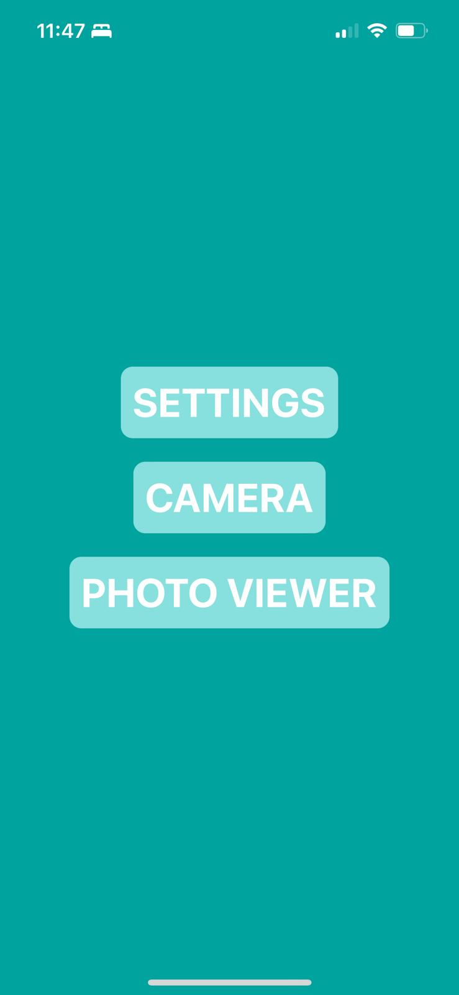
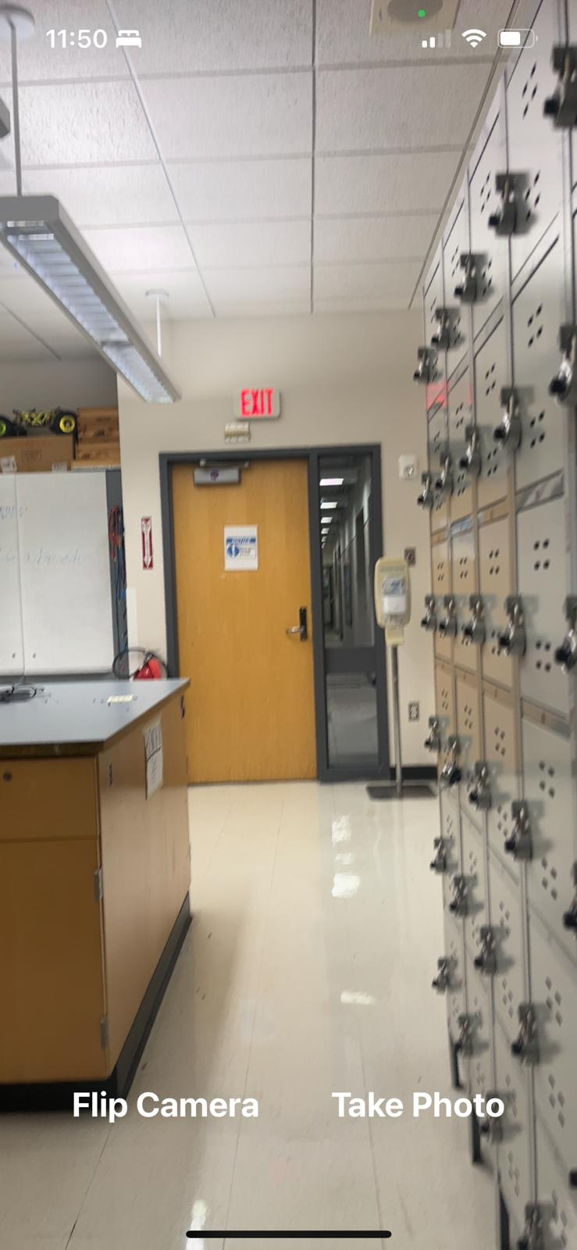
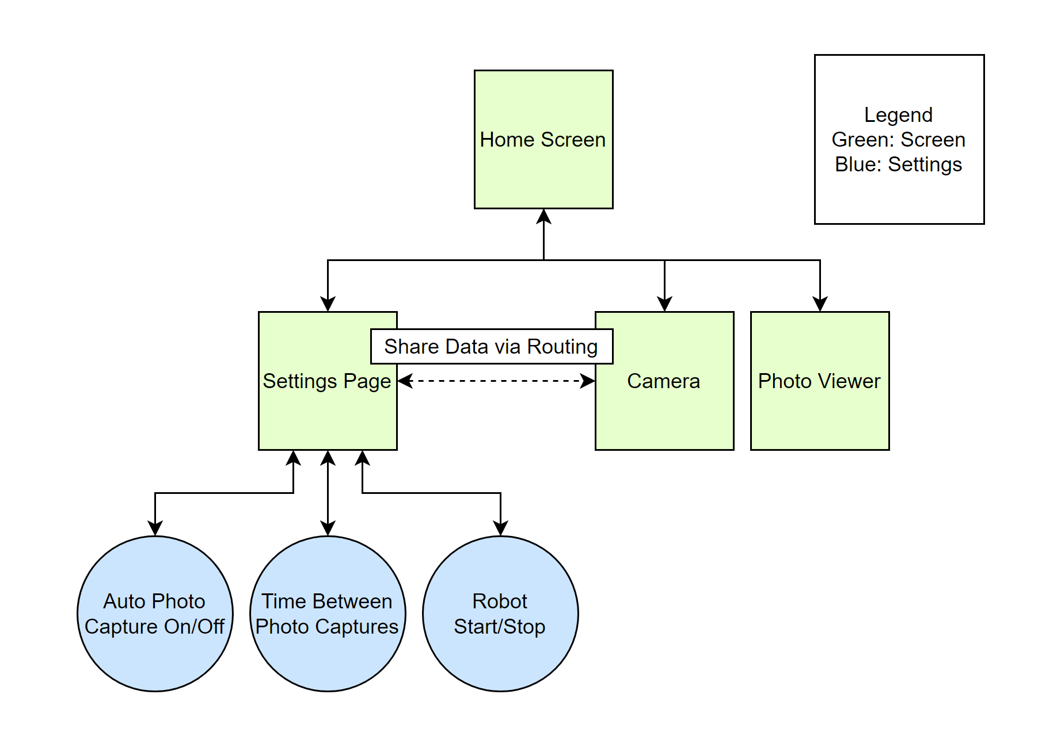
Application Block Diagram and Preliminary Styling
Notes:
Soph

Slide 14
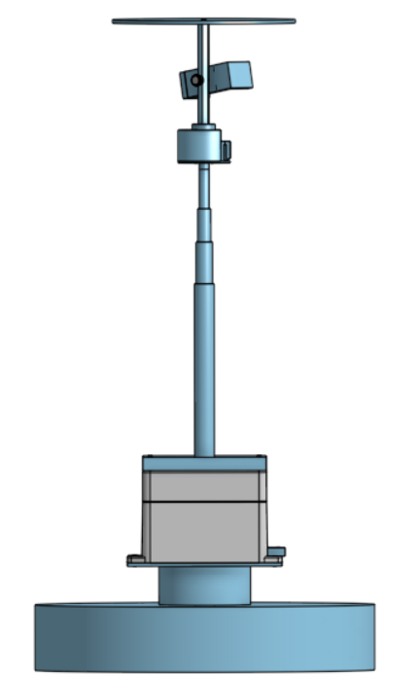
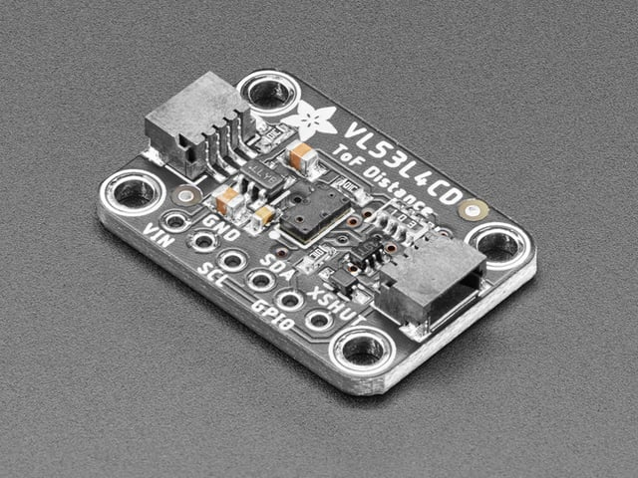
Obstacle Avoidance
Need to detect obstacles like tables that might collide with column
Light curtain using Adafruit VL53L4CD Time of Flight Distance Sensor
More range than available beam-break sensors
Narrow cone of detection
Notes:
Brett

Slide 15
Completed Work - Hardware
Designed
Phone mount assembly
Telescoping column attachment
Electronics bay and plates
Top plate
Fabricated
Motor plate
Distance sensor mount
Notes:
kev

Slide 16
Completed work - Electronics
Setting up the raspberry pi with portable power source.
Deciding which power output channel to use (usb A, usb C or GPIO) for motor and sensor.
Adding time of flight sensor, read distance with the pi.
Adding stepper motor driver and stepper motor, control rotation with the pi.
Notes:
Alex

Slide 17
Completed Work - Software & Networking
Two way communication between App and Server
Camera runs on mobile device, takes photos
Settings page allows for configuration
Routine start / stop
Time between photo capture
Auto capture on / off
Photos can upload to cloud storage
Robot navigation routine
Notes:
Soph

Slide 18
Work Remaining - Software & Networking
Communication between application screens (routing)
Implementation of variable photo-capture settings
Auto photo-capture code
Take photos every “X” seconds instead of on button click
Combining photo capture and photo upload code
Capture only saves one photo at a time
Cloud upload will save all photos
Spawn Python process from application
App sends message
Pi server receives message
Code spawns process, runs Python robot-control code
Obstacle avoidance and motor control
Notes:
Soph

Slide 19
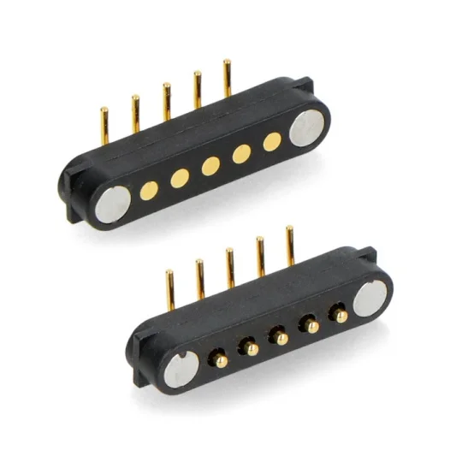
Work Remaining - Hardware
Design
Wiring/cable management for motor
Will likely use magnetic connectors and clips
Fabrication
Female threaded hex standoff
Top plate
Electronics bay plates
Modify ABS container for electronics bay
Notes:
Kev

Slide 20
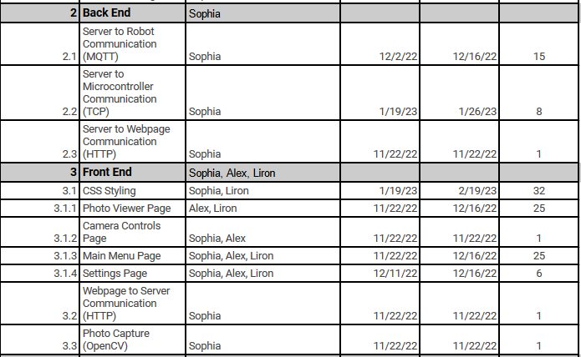
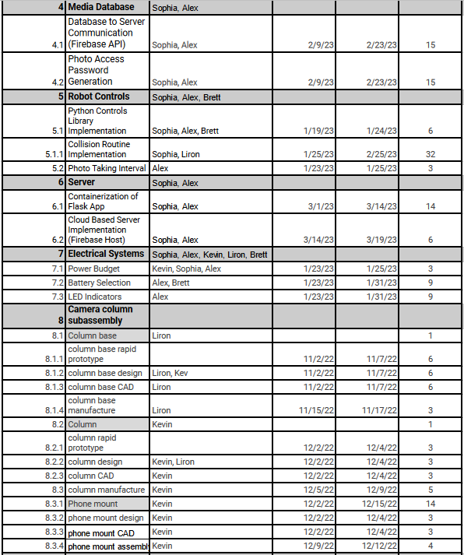
Progress
Task No Longer Relevant
Task Modified, Completed
Task Modified, In Progress
Task Completed
Task In Progress
In summary:
Running slightly behind, but still on track to complete by official test date
Notes:
kev

Slide 21
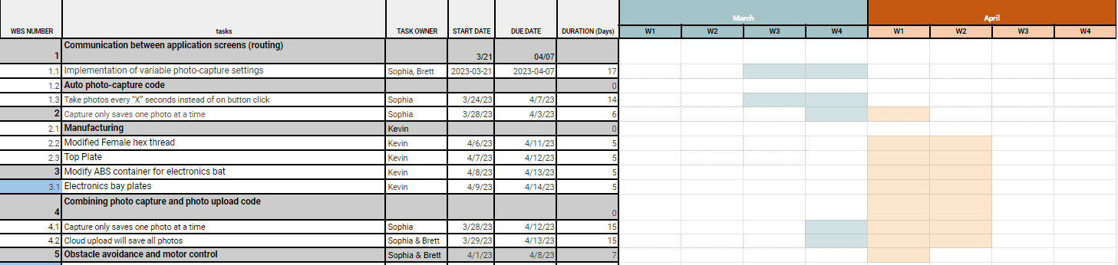
Gantt Chart

